Slide 1

Commissioner Hall
Community Conversation
September 26, 2022

Slide 2

Project Overview
Case Accumulation Defined
All cases (hearings, filings, applications) that were initiated before and during the pandemic (including those currently awaiting formal charging or filing) that have been impacted due to current limitations at various stages of the case administration process.
Since the beginning of COVID-19, the Fulton County Court System has amassed a significant and unprecedented level of cases. Project ORCA will address this challenge by utilizing a combination of capacity expansion and productivity enhancement initiatives to expedite the case adjudication process.
The COVID-19 Case Resolution Project began
on December 6, 2021 with 149,200 open and active cases.
As of September 4, 2022, there are 73,454 pending open and active cases.

Slide 3
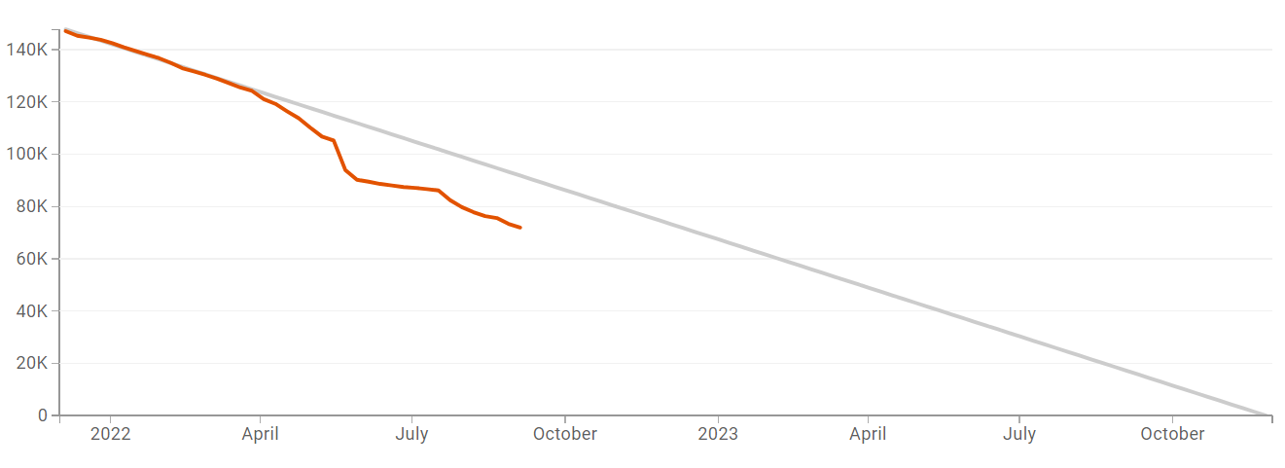
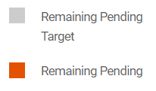
Case Disposition Progress
Disposition Status - OVERALL

Slide 4
Hiring Progress
Hiring Progress by Department As of 9/11/2022

Slide 5
Jail POPULATION
Design Capacity
Floor | 185 | 131 | 311 | 435
Book In | 59 | 36 | 42 | 53
Book Out | 71 | 21 | 41 | 63
Net | 12 | (15) | (1) | 10

Slide 6
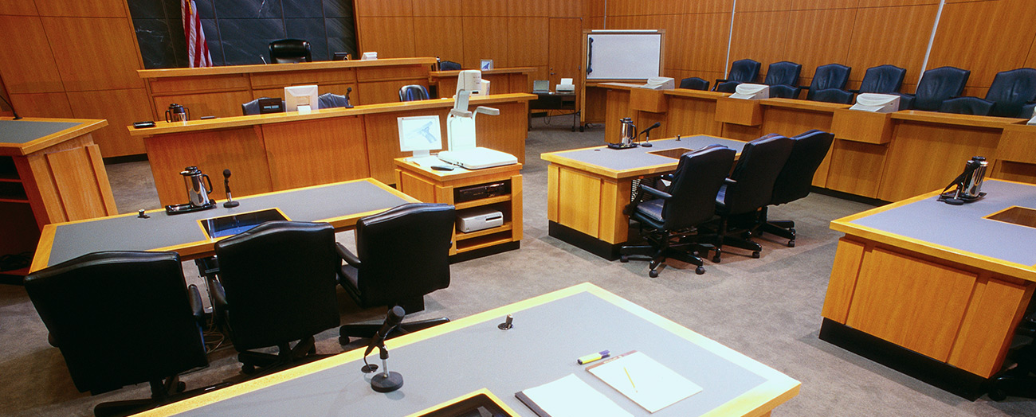
Issues & risks
Justice Partners continually discuss and review strategies to account for and mitigate the impact of the following issues and risks:
Increase in violent crime
Increase in jail population
Impact of increased violent charges
Sheriff and Marshal recruitment
Uptick in COVID cases

