Slide 1


BOARD OF ASSESSORS
"We build on a foundation of VALUE, SERVICE and TRUST"
2023 ANNUAL REPORT

Slide 2
The Board of Assessors (BOA) takes a great amount of pride in sharing its 2023 Annual Report of Fulton County, which constitutes the annual state of the office. Through its highly competent and trained staff, the BOA is charged with determining the fair and equitable value of all real and
tangible personal property within the county. Please consider this document as a reference guide that displays the importance and significance of the services our office provides and its impact on the communities where we work and call home. We acknowledge our responsibility to develop and maintain a high level of customer service to the community and work tirelessly to do the things necessary to foster an extraordinary working relationship with the community.
Fulton County can boast a uniqueness in the sense that the number of diverse communities, industries, and growth influences its character and presence. From the rural areas on the furthest north and south sides of the County to the areas impacted by gentrification, intown work/live
communities, and the suburban areas, these diverse residential communities have shaped the living experience in Fulton County. The continued growth in the movie industries, the re-emergence of the hospitality industry supported by a strong presence in sports and entertainment, the
increased need for housing units made way for apartments and the addition of leasable square footage in industrial warehousing has all contributed from a Commercial/Industrial standpoint.
As we continue to navigate the challenges of the “post-pandemic” era, the processes utilized by our office are continually validated to ensure a
feeling that doing business with the BOA is a pleasure and not a chore. You will find enhancements to our website to be beneficial. A couple of
features of note are that of the enhanced Property Search tool and the Comparison Search tool which is designed to assist taxpayers with identifying comparable properties and prepare them for their appeal, should they choose. While our online services significantly maximize convenience, our
office is still available to the public should they require in-person assistance.
While the market continues to be influenced by unpredictable factors, new construction appears to be consistent as a significant contributor to the
growth in the digest. It is important to make it abundantly clear that Appraisal staff does not predict the market; however, they do record the actions of the market as of January 1 of a given tax year based on the prior year’s market information.
The BOA looks forward to the opportunity to respond to any questions, concerns, or suggestions.
Mission Statement:
The Fulton County Board of Assessors provides exceptional customer service while delivering timely, accurate, and equitable property assessments in compliance with Georgia law and Department of Revenue guidelines. We are committed to maintaining the trust and confidence of our customers by upholding the highest standards of professionalism and dedication to serving their needs.

Slide 3


Table of
CONTENTS
Appraised Market Values..................... 1 - 3
Tax Districts and City Limits.............. 4
Residential Division Report.................. 5 - 8
Commercial/ Industrial Division Report
9 - 12
Personal Property Division Report........
13 - 16
Support Services Division Report..........
17 - 18
Mission: To promote integrity and professionalism in assessment administration through education, leadership, and cooperation.
Frequently Asked Questions.................
19 - 22
Area Landmarks.................................. 23 - 24
Appraisal Excellence............................ 25 - 26
Appraisal Timeline.............................. 27
Appeals Comparison............................ 28 Legislation......................................... 29
Public Information.............................. 30 - 32
IAAO serves property assessment professionals from government jurisdictions and agencies as well as various business and academic
communities.

Slide 4
2023 FULTON COUNTY MARKET VALUE
Tax Roll Year
2020
2021
2022
2023
Parcel Count
356,743
359,314
361,994
364,870
Personal Property Accounts
27,730
28,029
28,352
27,922
Market Value (B)
$173.3
$183.5
$198
$217
Assessed Value (B)
$69.3
$73.4
$79.2
$86.8
Market Value and Assessed Value are expressed in billions (B).
*Some Data Reported May Be Subject To Change
1

Slide 5
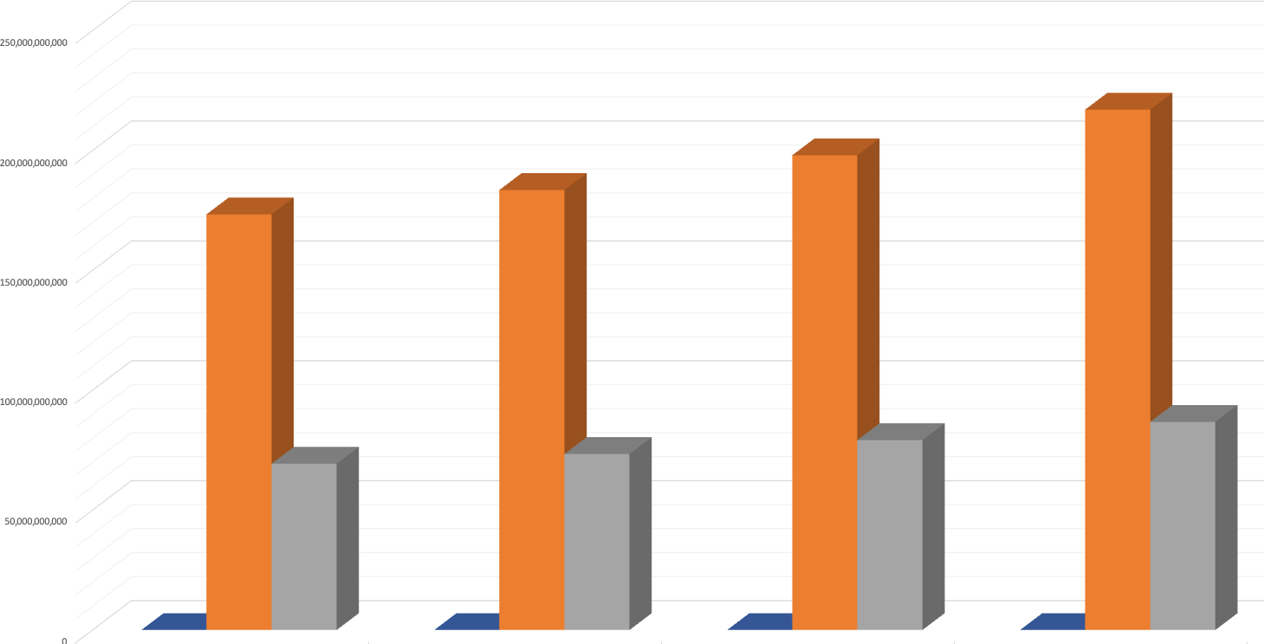
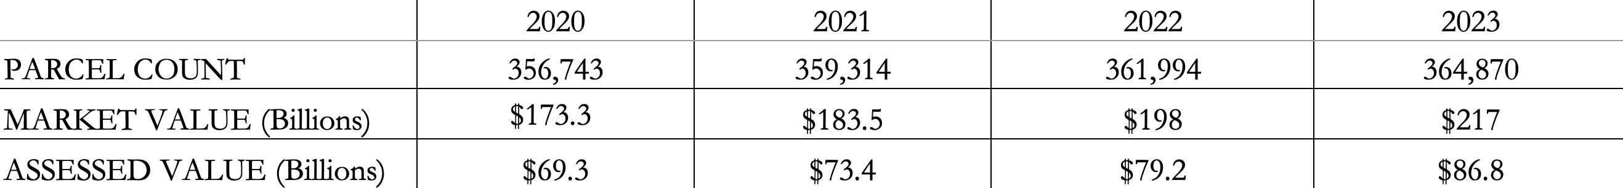



MARKET VALUE
*Some Data Reported May Be Subject To Change
2

Slide 6
2023 FULTON COUNTY MARKET VALUE BY TAX DISTRICT
ALPHARETTA
$17.3 BILLION
ATLANTA
$106 BILLION
CHATTAHOOCHEE HILLS
$792.8 MILLION
COLLEGE PARK
$1.9 BILLION
EAST POINT
$3.9 BILLION
FAIRBURN
$3 BILLION
FULTON INDUSTRIAL DISTRICT
$1.3 BILLION
HAPEVILLE
$1.1 BILLION
JOHNS CREEK
$14.3 BILLION
MILTON
$8.9 BILLION
MOUNTAIN PARK
$77.1 MILLION
PALMETTO
$689.4 MILLION
ROSWELL
$15.5 BILLION
SANDY SPRINGS
$25.7 BILLION
SOUTH FULTON
$12.9 BILLION
UNION CITY
$3.5 BILLION
3
*Some Data Reported May Be Subject To Change

Slide 7
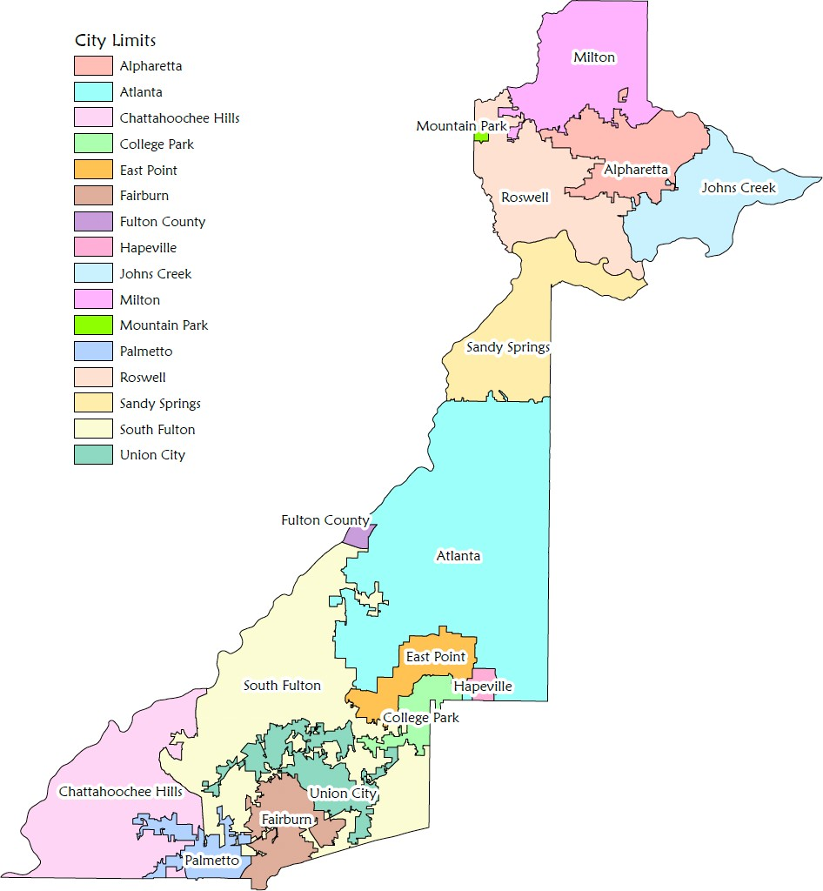
Fulton County Tax Districts and City Limits
4

Slide 8
RESIDENTIAL DIVISION
The Residential Division had an active market for the tax year 2023. Staff processed a sizeable number of sales, permitted activity, and land dimension changes over 500 splits and consolidations. They processed an estimated 14,000 permits and added almost 3,000 new homes and incomplete construction to the digest. They also reviewed about 40,000 sales and confirmed property characteristics for over 15,000 parcels.
This year has been considered a seller's market. We experienced a significant increase in residential sales activity in most areas of the county. Additionally, most of our new construction was primarily in the North and South regions of the county. This was due to the abundance of available undeveloped large-acre tracts in these areas. Both regions had the bulk of the land packages processed, in most cases subdividing parcel(s) into 50 or more residential lots.
For 2023, we had parcels with permitted activity identified as demos, additions, maintenance, and pools. The primary focus for maintenance and addition permits was in the 14th/17th tax districts (City of Atlanta). Property owners tend to make interior/exterior updates/renovations to their homes in these areas. There is less available land for building new construction. Therefore, demos and rebuilds are at a higher rate in these areas. (i.e., Mini Mansion, etc.).
Based on our sales analysis, many residential neighborhoods were subject to be adjusted to the market. After we reviewed the property characteristics of the homes, we identified almost 1,600 neighborhoods out of a total of about 3,400 residential neighborhoods that required market adjustments.
Overall, the Residential Division 2023 assessment notices for Fulton County reflect fair market value based on valid sales, detailed market analysis, market conditions and trends.
*Some Data Reported May Be Subject To Change
5

Slide 9
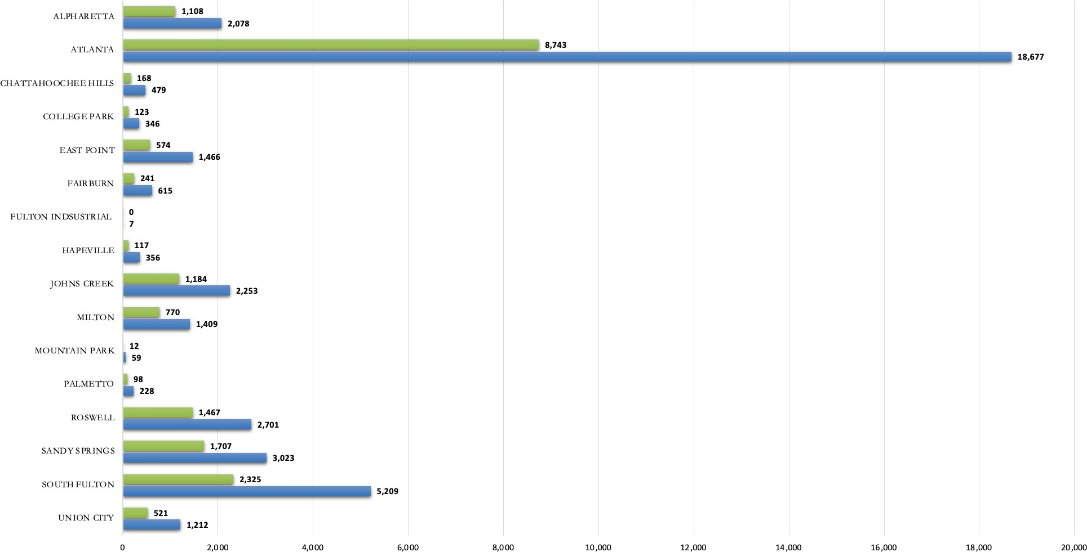
RESIDENTIAL DIVISION
RESIDENTIAL TRANSFERS
- VALID SALES
- TRANSFERS
*Some Data Reported May Be Subject To Change
6

Slide 10
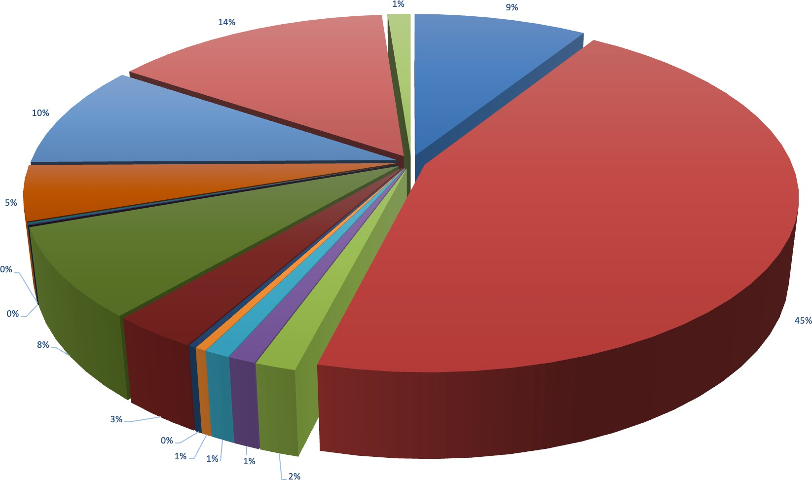
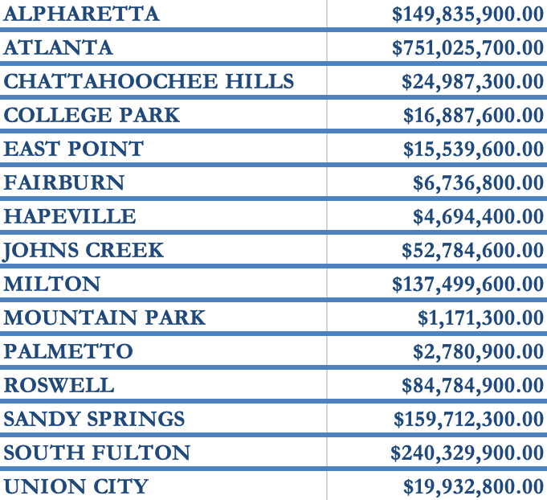
RESIDENTIAL DIVISION
RESIDENTIAL NEW CONSTRUCTION
333,218
RESIDENTIAL PARCELS
*Some Data Reported May Be Subject To Change
7

Slide 11
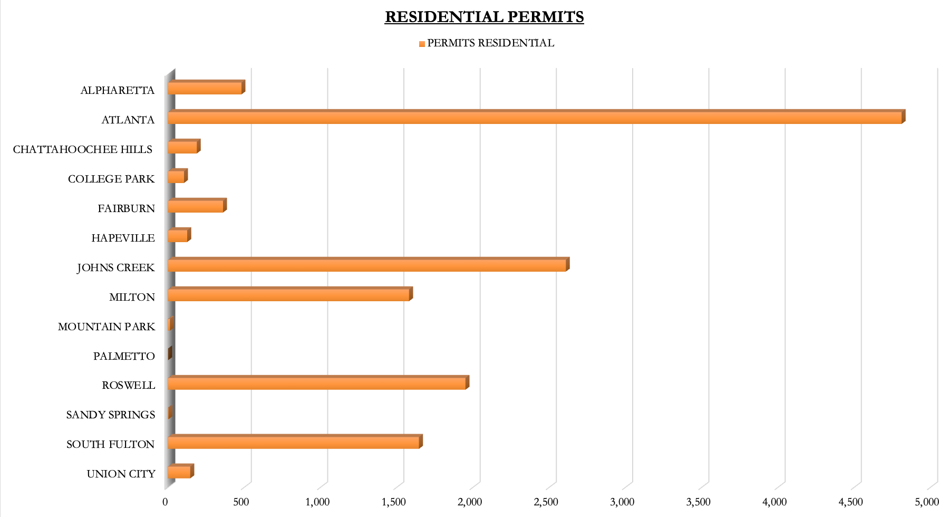
RESIDENTIAL DIVISION
*Some Data Reported May Be Subject To Change
8

Slide 12
COMMERCIAL/ INDUSTRIAL DIVISION
The Commercial/Industrial Division received about 5,000 sales for tax year 2023. The sale activity was concentrated in South Fulton where there is adequate vacant land for new development for industrial warehouses. There were almost 12,000 permits that were field inspected by the commercial appraisal team. The new and incomplete construction permits resulted in an added $3.7 billion in growth to the 2023 digest. The commercial team listed almost 200 new construction parcels and about 150 parcels coded as incomplete construction.
The Fulton County submarkets that represented the bulk of new construction/incomplete construction are South Fulton with industrial, manufacturing, and cold/dry storage warehouses; Midtown with new hospitality, offices, and apartments; and North Fulton with new hospitality venues, offices, and retail. Some of the more notable new construction projects for 2023 are Invesco, One Phipps Plaza Office, the Hyatt Centric Hotel, Kimpton Shane Hotel, Broadstone Upper Westside Apartments, Nobu Hotel, Ascent Peachtree Apartments, Novel Apartments in Buckhead/Midtown, and DP World Logistics Warehouse in South Fulton. As a result, there is high demand for warehouses, multi-family, and affordable housing.
Existing Development Authority parcels by municipalities are Atlanta with 41, Sandy Springs with 15, Alpharetta with 29, East Point with one, and Union City with two. There are currently 254 projects included in the Development Authority program. New Development Authority projects by municipalities for tax year 2023 are Fulton with 31, Atlanta with 18, Alpharetta with eight, East Point with two, and Union City with two for a total of 61. As of tax year 2023, Fulton County has a total of 315 Development Authority parcels in the program.
Staff received and processed a total of 11 new Brownfield applications for tax year 2023, which represents a total of 77 Brownfield parcels. With the increase in the demand for affordable housing, we have received and processed a total of five new Low-Income Housing Tax Credit applications, which provides a total of 137 Low- Income Housing Projects. With the continued demand and trends to make affordable housing more available nationwide this has impacted Fulton County real estate developers in how to repurpose non-performing office buildings for future affordable housing communities. On the other hand, the growth and demand for housing has significant effects on escalating rental rate growth and new development of new multi-family housing throughout the county.
There has been an increase and continued national demand for more warehouse space to support import and e-commerce fulfillment centers. It has been noted that the trend in 2023 will extend into tax year 2024 for the demand of warehouse space in Fulton County. Staff received and processed almost 700 land packages which consist of land splits, consolidations, right-of-way, make taxable, dimension changes, and air right parcels.
As a result of an abundance of valid sales, the commercial division reviewed sales which resulted in market adjustments to five property types that includes about 85 land use codes. They include offices, industrial, hospitality, multi-family apartment, and retail. Due to market research and data analysis, staff adjusted market rental rates, expenses, and capitalization rates.
Overall, the 2023 notice of assessments for Fulton County taxpayers reflects Fair Market value based on sales, market analysis, market conditions, and industry trends.
9
*Some Data Reported May Be Subject To Change

Slide 13
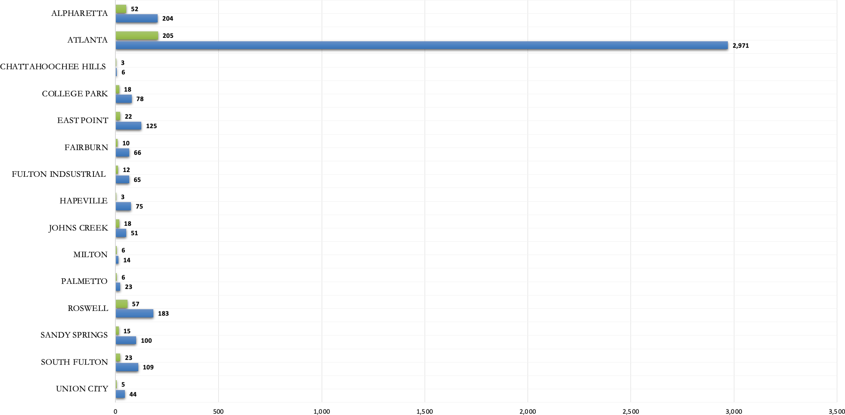
COMMERCIAL/ INDUSTRIAL DIVISION
COMMERCIAL/ INDUSTRIAL TRANSFERS
- VALID SALES
- TRANSFERS
*Some Data Reported May Be Subject To Change
10

Slide 14
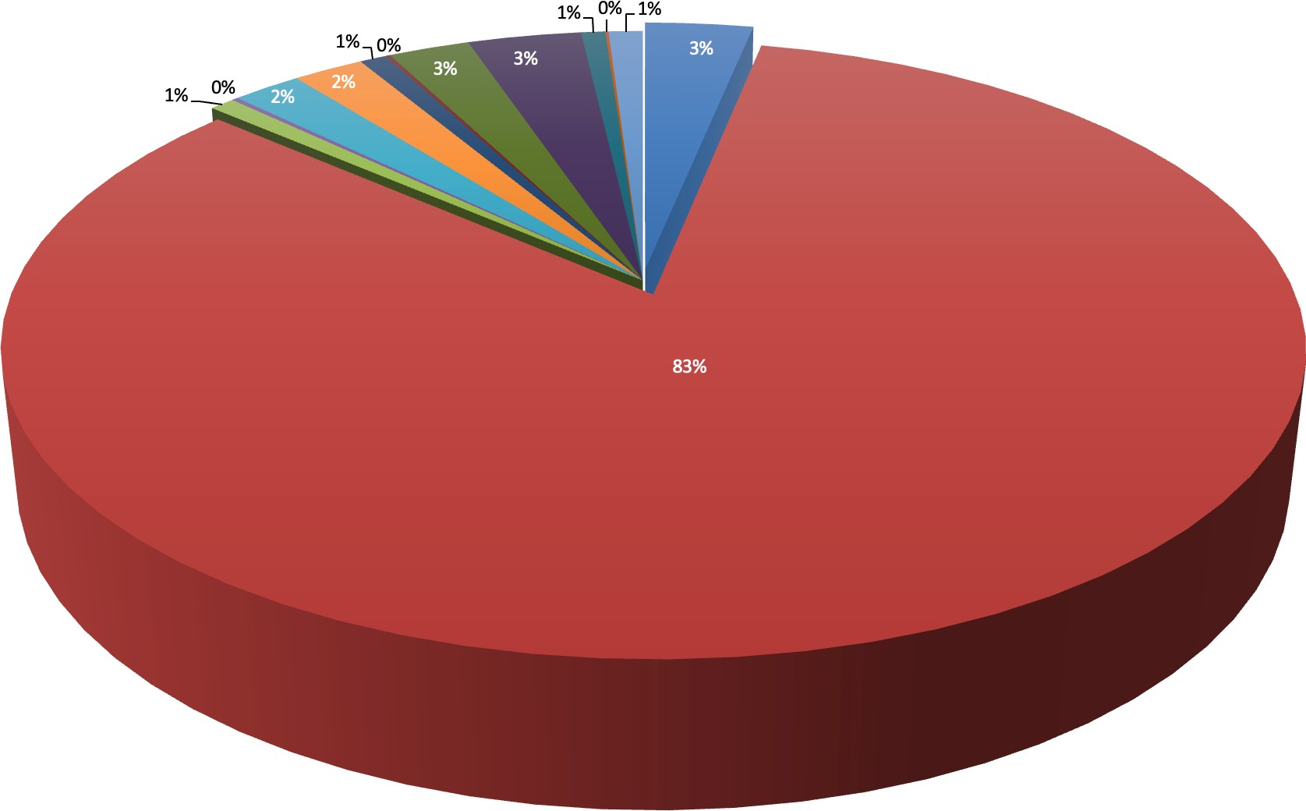
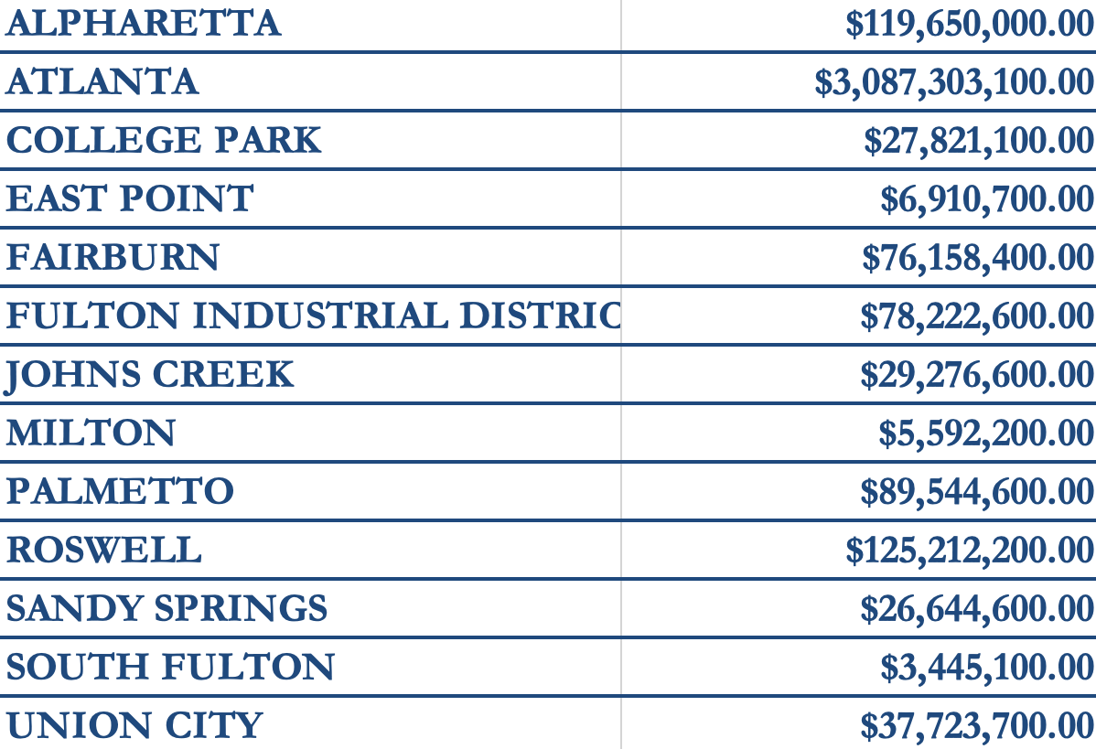
COMMERCIAL/ INDUSTRIAL DIVISION
COMMERCIAL/ INDUSTRIAL NEW CONSTRUCTION
11
*Some Data Reported May Be Subject To Change

Slide 15
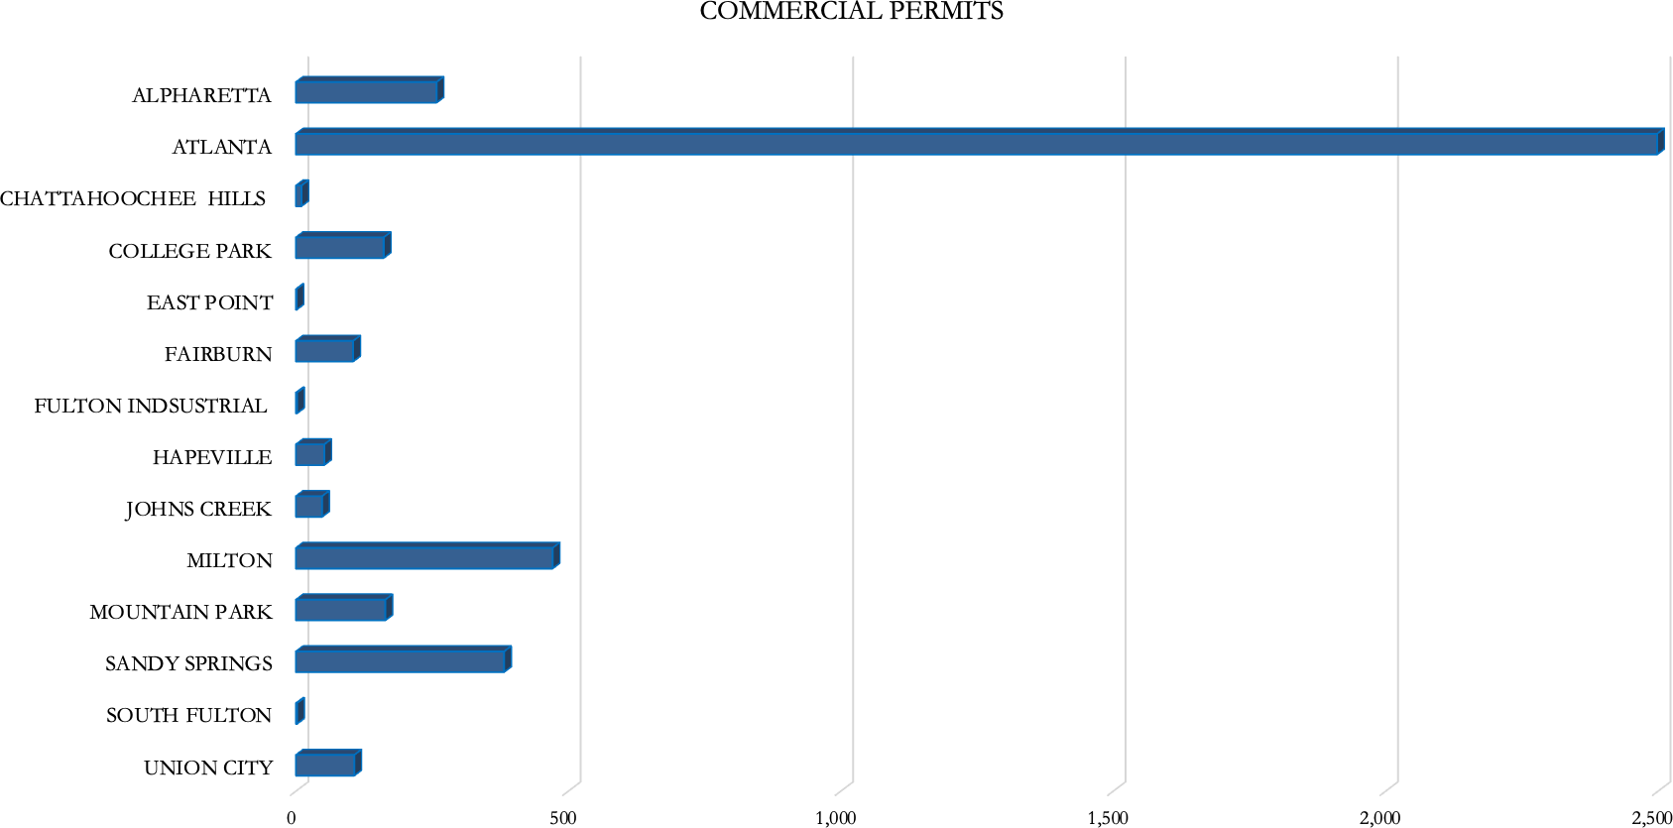
COMMERCIAL/ INDUSTRIAL DIVISION
*Some Data Reported May Be Subject To Change
12

Slide 16
PERSONAL PROPERTY DIVISION
The Personal Property Division received approximately 16,000 returns for 2023. This is 1,100 more than the returns received in the previous year. There were 435 Freeport applications processed at the time notices were mailed, compared to 473 last year. The total Freeport applications received were 557.
The Personal Property digest increased overall by 13% from tax year 2022 to tax year 2023, compared to 9% from 2021 to 2022. This was largely due to increased inventory and equipment of manufacturing companies.
While the number of boats stayed relatively the same, the number of aircraft increased by 14% due to enhanced discovery efforts. This resulted in a $330 million increase in value.
The field review project for 2023 focused on malls and shopping centers. This resulted in the discovery of 103 businesses not on the digest, with an estimated total value of $19.5 million.
There were 47 vehicle appeals received and processed as of mid-year 2023, compared to 37 in 2022.
*Some Data Reported May Be Subject To Change
13

Slide 17

2023 PERSONAL PROPERTY
27,084
BUSINESSES
91
AIRCRAFT
312
BOATS
435
FREEPORT
*Some Data Reported May Be Subject To Change
14

Slide 18
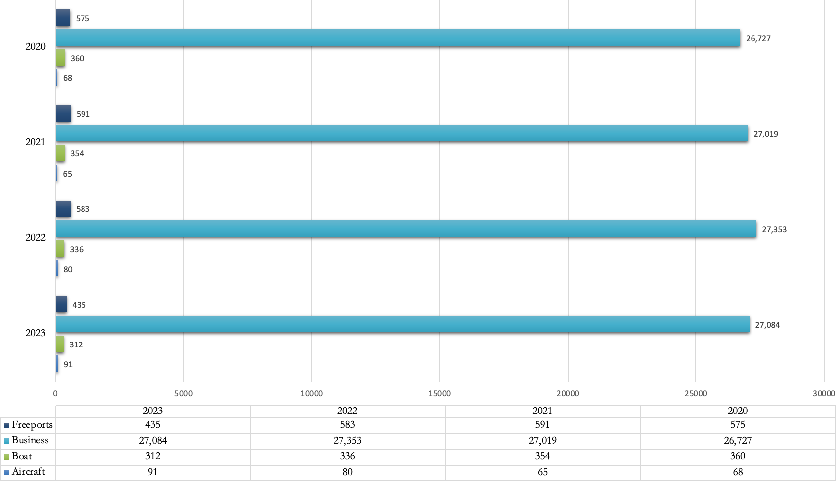
PERSONAL PROPERTY DIVISION
ACCOUNTS
15
*Some Data Reported May Be Subject To Change

Slide 19
FAIR MARKET VALUE
 |  | 2020 | 2021 | 2022 | 2023
BUSINESS (B) |  | $34.5 | $34.4 | $36.1 | $36.6
AIRCRAFT (B) |  | $1.3 | $1.5 | $1.9 | $2.3
BOATS (M) |  | $4 | $3.9 | $4.1 | $4
FREEPORT (B) |  | $12 | $13.9 | $15.7 | $21.7
TOTAL (B) |  | $47.8 | $49.8 | $53.7 | $60.6
*Some Data Reported May Be Subject To Change
16

Slide 20
SUPPORT SERVICES DIVISION
Our Field Book Division is responsible for processing deeds transfers for each tax year to reflect real estate data including property ownership and the legal description of the property so transferred. For 2023, our Field Book staff processed 44,000 deeds compared to approximately 48,000 deed transfers in the preceding tax year. This still accounts for the most deed transfers for a county in the state of Georgia.
In conjunction with our Field Book Division, our GIS Division provides mapping and data services for the Tax Assessor’s Office that is utilized to analyze and display the current year configuration of parcels in the county. Staff is responsible for updating and maintaining a variety of data layers, develops and maintains the county's spatial databases, and provides mapping and data services to local government departments throughout Fulton County. They process the various splits, dimension changes, and combinations of properties through land packages along with processing right-of-way deeds and
other parcel changes. Our GIS Division processed 1,020 land packages that consisted of over 4,600 parcels for the current tax year.
Our Homestead Division is responsible for processing homestead applications for those property owners in Fulton County who own and occupy their property on January 1 of the current tax year. Homestead exemptions serve to effectively reduce the tax burden on property owners whose primary residence is located in Fulton County. Our office received approximately 22,000 homestead applications for tax year 2023. This includes basic homestead exemption filings along with applications for senior, income, disability, veteran, and various other special homestead exemptions for which Fulton County residents might qualify. Sixty-five percent of those filings were submitted using our online portal. The remaining applications were primarily filed manually at one of our six locations throughout the county.
*Some Data Reported May Be Subject To Change
17

Slide 21
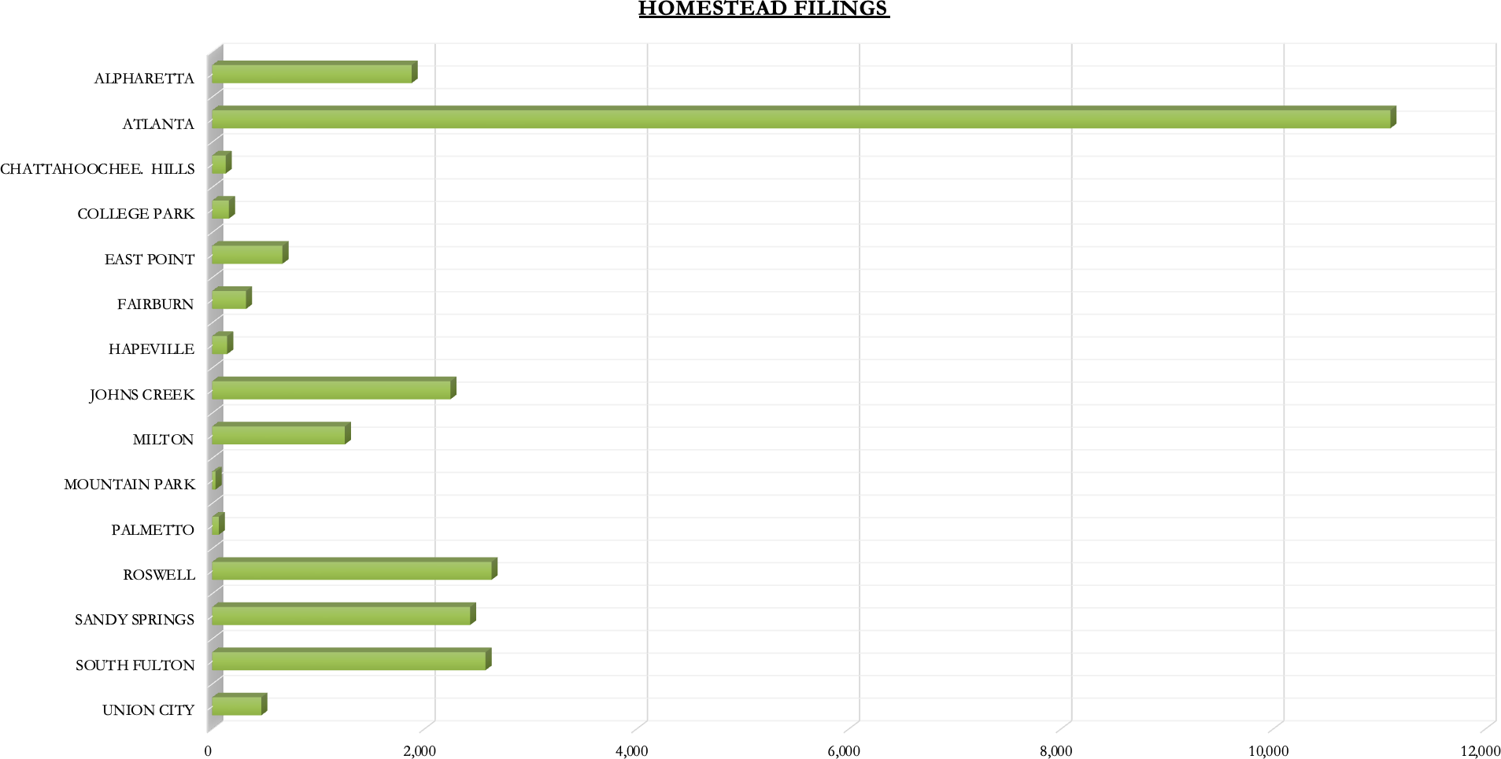
SUPPORT SERVICES DIVISION
*Some Data Reported May Be Subject To Change
18

Slide 22
?
?
DID YOU KNOW?
?
?
19

Slide 23


WHAT ARE THE DUTIES OF THE BOARD OF ASSESSORS?
Appraise all real and personal property Process exemption applications Maintain records of property ownership Maintain property tax maps
Prepare real and personal property tax digest annually Process property appeals
WHO SETS THE MILLAGE RATES (TAX RATES)?
The Board of Commissioners, Atlanta & Fulton County School Boards, and city governing authorities set the millage rates.
WHEN DO I APPLY FOR HOMESTEAD EXEMPTION OR ANY OTHER EXEMPTION?
You can apply for homestead exemption year-round. However, you must apply by April 1st for the exemption to be effective for the current year. Applications received after April 1st will be processed for the following year.
WHAT ARE THE DUTIES OF THE TAX COMMISSIONER?
Calculate and print tax bills Collect taxes
Distribute revenues to the County, School Boards, and
Municipalities
Process motor vehicle tag applications & renewals
WHAT IS A HOMESTEAD EXEMPTION?
An exemption approved by the Georgia voters that exempts from taxation a specified amount of assessed value of your owner-occupied dwelling.
IS THE ASSESSMENT NOTICE I RECEIVED THE SAME THING AS MY PROPERTY TAX BILL?
No. The assessment notice is not a bill. Although Georgia law requires that the assessment notice give an estimated tax amount, its primary purpose is to advise of your property’s appraised value as established by the Board of Assessors. Do not send payments until you receive a tax bill from the Tax Commissioner.
20

Slide 24



WHO QUALIFIES FOR HOMESTEAD EXEMPTION?
If you are the owner and reside at the property on January 1st, you qualify for Homestead Exemption that year. The property must be your primary residence.
DO I HAVE TO APPLY FOR HOMESTEAD EXEMPTION EVERY YEAR?
IF I OWN MORE THAN ONE PROPERTY, CAN I GET A HOMESTEAD EXEMPTION ON MORE THAN ONE PROPERTY?
No. It is illegal to have more than one Homestead Exemption in this state or any other state. You can only receive an exemption on the home you consider your primary residence.
No. Once granted Homestead exemption, you do not have to reapply again unless there is an ownership change on the deed to the property or if you move to a different location that you claim as your primary residence.
If you reach an age where you may qualify for senior exemptions, you must file for those exemptions, as they are not applied automatically.
You must also apply for disability and other special exemptions.
WHEN IS THE LAST DAY TO FILE A RETURN (REAL PROPERTY, BUSINESS PERSONAL PROPERTY, MARINE & AIRCRAFT)?
Returns must be filed on or before April 1 each year. Returns filed on April 1, must be postmarked by April 1st to be considered timely. Pitney Bowes or other metered mail date stamps will not suffice.
WHAT IS FREEPORT EXEMPTION?
Freeport exemption is an exemption on inventory of Georgia manufacturers, wholesalers and distributors. The exemption must be applied annually by April 1 www.fultonassessor.org on the Forms and Documents page to receive maximum exemption. Applications are also accepted until June 1st but with reduced exemption granted. Forms are available here.
21

Slide 25






WHO DETERMINES THE VALUE OF MY PROPERTY FOR TAX PURPOSES?
The Fulton County Board of Assessor’s (BOA) appraisal staff determines and makes recommendations to the BOA. The Board of Assessors approves the values.
HOW IS FAIR MARKET VALUE DEFINED?
Fair market or appraised value is the amount a willing seller would sell and a willing buyer would purchase a property in an arm’s length bona fide transaction.
HOW DOES THE ASSESSORS’S OFFICE DETERMINE THE VALUE OF MY HOUSE?
The appraisal staff gathers and verifies property characteristics such as age of the home, square footage, bed and bath count, exterior covering, and type/quality of construction. The staff then utilizes the three approaches to value, cost, market and income to determine a value.
WHAT IS THE ASSESSED VALUE OF A PROPERTY?
Assessed value is 40% of the fair market value.
I DISAGREE WITH MY APPRAISED VALUE. CAN I APPEAL?
Appeals can only be filed in response to an Annual Assessment Notice. When you receive your Notice you will have 45 days from the Notice Date displayed on the form to file your appeal.
22

Slide 26
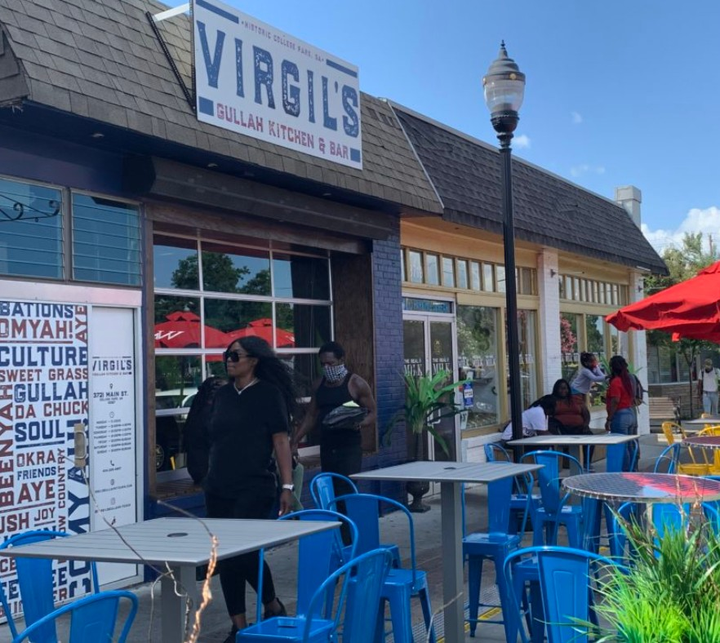
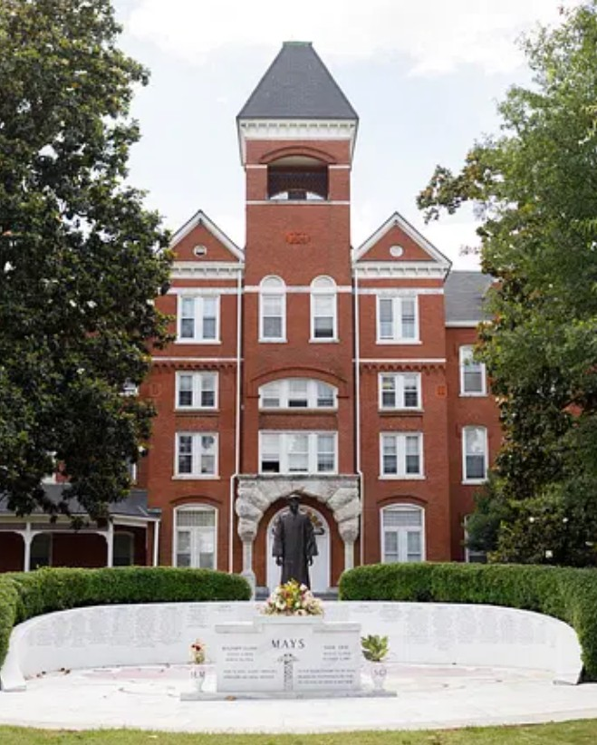






23

Slide 27

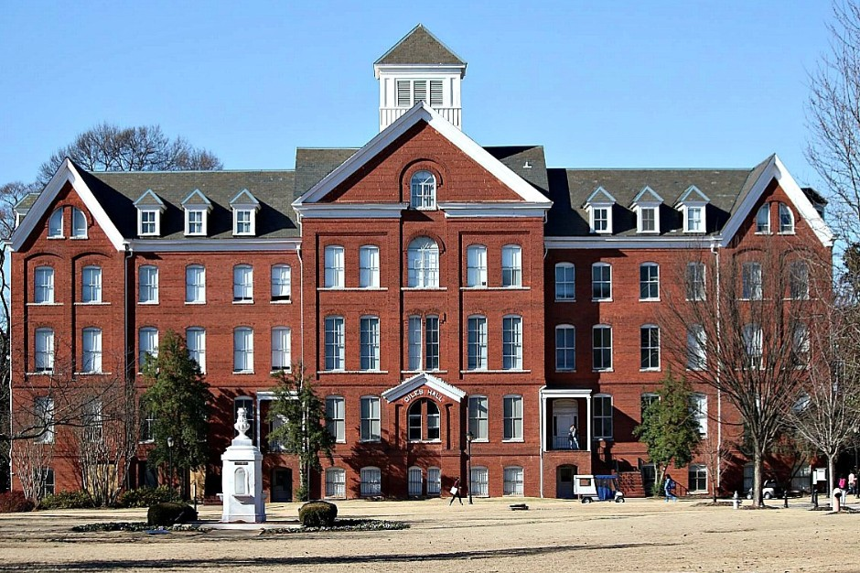


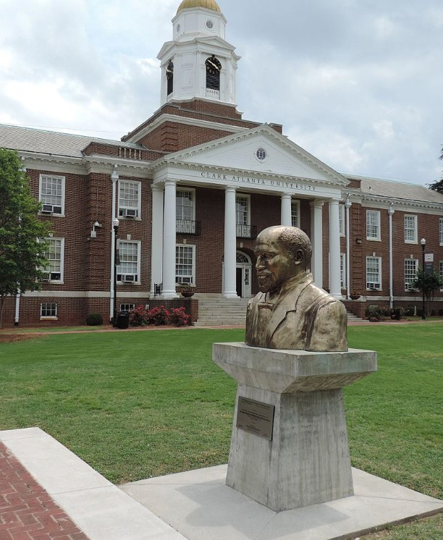


24

Slide 28
APPRAISAL EXCELLENCE
The Georgia Department of Revenue is required to instruct, operate, and administer courses of instruction to provide for the training and continuing education of county tax officials.
The Georgia Certification Program Objectives are:
To encourage the recognition of assessment administration in local government as a profession established upon an identifiable body of knowledge and to offer courses of study through which such knowledge may be acquired;
To foster and maintain high educational and ethical standards in the practice of assessment administration;
To assist the local assessors and staff by establishing a program that builds professionalism; and To provide recognition for assessors, appraisers, and staff.
25

Slide 29


21
APPRAISAL EXCELLENCE
APPRAISER I
APPRAISER II
24
15
APPRAISER III
APPRAISER IV
20
92
1 , 042
Appraisal Staff & Divisional Leadership
Years of Staff Experience
26

Slide 30


APPRAISAL TIMELINE
April 1st:
Real & Personal Property Returns
April 1st:
Homestead Exemptions for current Tax Year
(applications are accepted year-round)
July 1st:
Deadline to mail Notice of Assessment
Appeal Period:
45 days from the date of Notice of Assessment
Digest Submission:
No later than September 1st
27

Slide 31
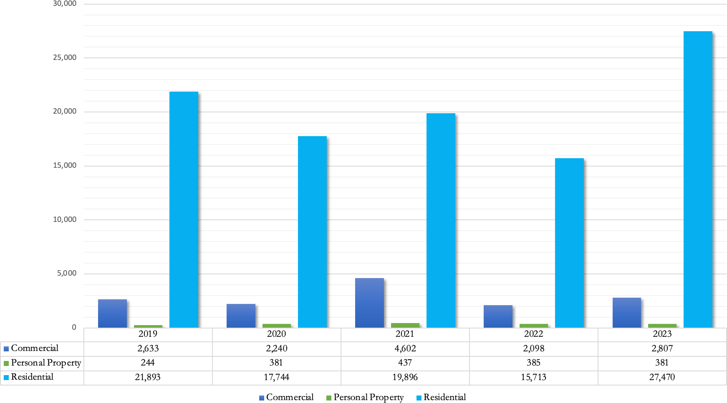
APPEALS COMPARISON
*Some Data Reported May Be Subject To Change
28

Slide 32

LEGISLATION
HB270
A BILL to be entitled an Act to provide a homestead exemption from City of College Park ad valorem taxes for municipal purposes for the full amount of the assessed value of the homestead for residents of that city who are disabled or who are 65 years of age or older and whose income, together with the income of the spouse who also occupies and resides at such homestead, does not exceed the maximum amount which may be received by an individual and an individual's spouse at full retirement age under the federal Social Security Act for the immediately preceding year; to repeal conflicting laws; and for other purposes.
https://www.legis.ga.gov/legislation/64072
29

Slide 33
PUBLIC INFORMATION
AVAILABLE FILINGS:
Homestead & Special Exemptions
Real Property Returns (Jan. 1 – April 1)
Business Personal Property, Aircraft & Marine Returns (Jan 1 – April 1)
Real and Business Personal Property Appeals
Change of Mailing Address (Real Property Only)
ENHANCED FEATURES:
We are pleased to provide an enhanced property search tool on our website!
The search tool is easier to navigate and will improve the user experience. Also available is a comparable search module which allows the
selection compare selection
of various property characteristics to similar types of properties. Once the
criteria are entered, a report is
generated that includes a data summary of each property and a map displaying the parcels.
ONSITE PAPERLESS FILING:
Onsite paperless f i l ing is now available for your convenience at all our homestead locations. Taxpayers simply provide the information necessary to qualify for an exemption without the need to f i l l out a
paper application.
As a courtesy, required documentation necessary for f i l ing is immediately scanned into our system and returned to the taxpayer. For a Basic Exemption, this includes a valid Georgia Driver’ s License or
Georgia Identification card as well as the registration for vehicles owned by and registered in the name of the property owner and spouse.
For those f i l ing for senior and other special exemptions, additional documentation may be required. This includes such items as State and Federal Tax returns or, if you do not f i le income tax, a Social Security Award letter. These items are scanned in and immediately returned also.
Before leaving, you will review a printed receipt with all your pertinent information included and sign verifying that your information is correct. Staff will scan the receipt into our system and return the
signed receipt to you for your records. The signed receipt includes the oath that all information provided by the taxpayer is correct.
30

Slide 34

ELECTRONIC ANNUAL NOTICE OF ASSESSMENT
FOR TAX YEAR 2024
You now have the ability to receive your
Annual Notice of Assessment electronically.
To opt in, click the Access E- Notice Portal
l ink and create an account. You will need the Registration ID printed on the 2023 Annual Notice of Assessment.
If you have opted to receive your Annual
Notice of Assessment electronically, you will be notified by mail once i t i s made available.
If you have difficulty retrieving your notice at that time, please send an email to
edocs@ southdata. com. A representative will respond during normal business hours.
31

Slide 35



Locations:
Peachtree Center ( Administrative Office) 235 Peachtree Street, NE, Suite 1400
Atlanta, Georgia 30303
Fulton County Government Center 141 Pryor Street, Suite 1018
Atlanta, Georgia 30303
Fulton County Customer Service Center 11575 Maxwell Road, Suite 102
Alpharetta, Georgia 30009
Greenbriar Mall
2841 Greenbriar Parkway, Suite 124 Atlanta, Georgia 30331
North Fulton Service Center
7741 Roswell Road, NE, Suite 210 Sandy Springs, Georgia 30350
South Fulton Service Center
5600 Stonewall Tell Road, Suite 224 Atlanta, Georgia 30349
32

Slide 36
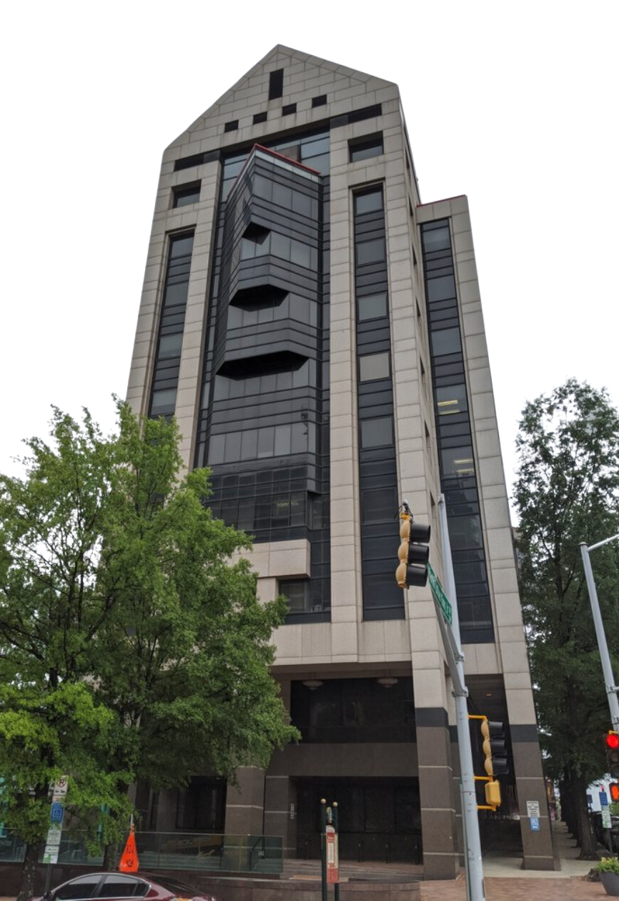
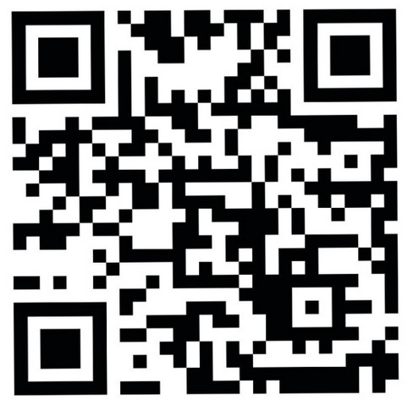



BOARD MEMBERS:
Edward London - Chairman
Pamela Smith - Vice-Chair Michael Fitzgerald Melinda Kaplan
Lee Morris
Roderick Conley, AAS, RES, GCA Chief Appraiser
Contact Us
boa@fultoncountyga.gov 404-612-6440
www.fultonassessor.org
SCAN ME

